Slide 1

using github
Sarah Ley & Margarete Lengger

Slide 2
solving a merge conflict
what is that?
2 collaborators worked on the same file (file3.txt) and they both modified it. In order to keep just one version going forward, the merge conflict has to be solved.

Slide 3
Open the file in question.
Find the merge conflict in the lines where both collaborators made changes.
The conflict is inside the conflict markers:
<<<<<<< HEAD (= this is where one version of code begins).
Next to that it says ====== (= this is where the second version of code begins).
>>>>>>> BRANCH-NAME marks the end of the merge conflict.

Slide 4
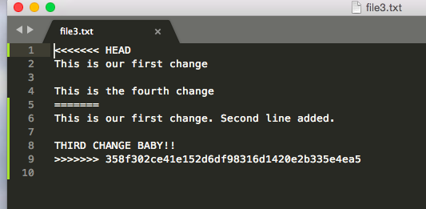

Slide 5
4. Either choose one of the versions of code or make a third, new version.
5. Delete the conflict markers.
6. Add these changes via $ git add .
7. Explain what you did via $ git commit -m “resolved merge conflict in line 5”
8. Push the file to Github via $ git push

